Slide 1


Department of Computer Science and Engineering
Deep Learning-Based Determination of Cocopeat for Water Retention in Agricultural Practice
B21A2425C32
NITHINPRANAO.S.K (210701180)
PRADEEP RAM.V (210701188)
MR.RAGU.G

Slide 2
Problem Statement and Motivation
With the increasing global population, the scarcity of water resources will be intensified to make this issue one of utmost importance in managing water in agriculture. Saving water is very important in agricultural productivity and also in the long run survival of farming. Cocopeat, as a product of processed coconuts, has now become an important substrate in agriculture since it can retain water to create a suitable environment for plants to grow steadily. The only challenge is in determining how much coco pith is suitable for what type of soils as they pose different water-holding capacities and environmental requirements. The traditional ways of substrate management are mostly based on heuristic methods or general guidelines that do not consider the diversities found in plant species as well as the environment.

Slide 3
Objectives
Soil Texture Classification:
The goals are to classify various soil textures like sand, silt, clay.
Coco Peat Recommendation:
Based on its texture and qualities, this purpose is looking forward to suggesting the ideal amount of cocopeat required for enhancing soil health.
Real Time Analysis:
To develop an intuitive interface for classifying soil textures in real time and recommending cocopeat.

Slide 4
Abstract
Soil surface texture classification using RGB images represents an innovative approach to soil analysis, providing a cost-effective and efficient alternative to traditional methods. This study explores the potential of using RGB imagery, captured by standard digital cameras, for accurate classification of soil textures, including cocopeat. By applying image processing techniques and machine learning algorithms, we aim to distinguish between different soil textures such as sand, silt, clay, and cocopeat. The methodology involves collecting soil samples, including cocopeat, capturing high- resolution RGB images, and pre-processing these images to enhance feature extraction. Key features, including color histograms, texture descriptors, and spatial patterns, are extracted.

Slide 5
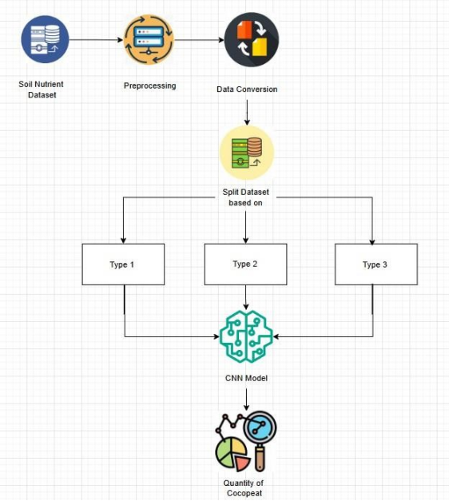
System Architecture

Slide 6
List of Modules
Image Acquisition and Pre-processing Module
Feature Extraction Module
Classification and Prediction Module
User Interface Module

Slide 7
Functional Description for each modules with DFD and Activity Diagram
Image Acquisition and Pre-processing Module:
Standard digital cameras capture soil images in controlled lighting.
Techniques like contrast enhancement, noise reduction, and normalization prepare
consistent, high-quality inputs for feature extraction.

Slide 8
Functional Description for each modules with DFD and Activity Diagram
Feature Extraction Module:
Extracts key soil characteristics from preprocessed images to create a structured dataset.
Texture Descriptors:Local Binary Patterns (LBP) and GLCM analyze granularity, roughness, or smoothness.
Color Histograms: Capture color distributions.
Spatial Patterns: Provide insights into soil particle arrangements.
Outcome: Generates features that help differentiate soil types (sand, silt, clay) and identify deficiencies for cocopeat recommendations.

Slide 9
Functional Description for each modules with DFD and Activity Diagram
Classification and Prediction Module:
Classifies soil textures and provides confidence scores for predictions.
Analyzes features of input images.
Categorizes soil into sand, silt, or clay.
Feeds classified soil type into the Cocopeat Recommendation Module for precise soil improvement advice.

Slide 10
Functional Description for each modules with DFD and Activity Diagram
User Interface Module:
Enables users to interact with the system effortlessly.
Upload or capture soil images.
View classification results and cocopeat recommendations.

Slide 11
Implementation & Results of First Module
The system calculates the exact amount of cocopeat required for each soil type, avoiding waste and ensuring cost-effective usage.
The practical recommendations directly improve crop yield by addressing specific soil shortcomings.
This module ensures that the treatment is customized for each soil texture, making it more effective than generic methods.

Slide 12
Conclusion & Work for Phase II
The system can enhance its utility by considering the type of crops (e.g., rice, tomatoes, wheat) and soil types (e.g., saline, peaty) to provide individualized recommendations for cocopeat usage. This approach improves water retention, aeration, and nutrient supply tailored to the specific growth requirements of diverse plants.
By integrating real-time data on climatic factors like temperature, humidity, and rainfall, the system can adjust cocopeat recommendations dynamically. This ensures optimal growth conditions are maintained across varying climates, seasons, and geographic locations.

Slide 13
References
1. D. N. Kiran Pandiri, R. Murugan and T. Goel, "Multi Feature Fusion for Soil Image Feature Extraction and Classification Using Machine Learning," 2023 3rd International Conference on Smart Generation Computing, Communication and Networking (SMART GENCON), Bangalore, India, 2023, pp. 1-6.
2. D. Sivabalaselvamani, L. Rahunathan, K. Nanthini, T. Harshini and C. Hariprasath, "Soil Classification using Deep Learning Techniques," 2023 Second International Conference on Augmented Intelligence and Sustainable Systems (ICAISS), Trichy, India, 2023, pp. 582-586.

Slide 14
Paper Publication Status
Applied and Waiting for acceptance

Slide 15
Thank You

